Slide 1
LibroWave
OSCAR MANUEL CONCEPCION NAPOLES
MARYAM NADHIM EDAM, EDAM
SMAIL DAHMANI

Slide 2
Tabla de Contenidos
01.
Arquitectura de la informacion
02.
Wireflow& HTA
03.
Prototipo de baja Fidelidad

Slide 3
Navigation system
The application will utilize a tab-based navigation system to streamline user interaction.
Each tab corresponds to a distinct section of the app, allowing users to navigate seamlessly through different functionalities

Slide 4




Navigation system
Home
Books
Forum
Profile

Slide 5
Navigation system
Home
Serves as the central hub, providing an overview and quick access to key features.
Users can explore various sections of the app from the home screen.

Slide 6
Navigation system
Books
Dedicated to discovering available books for rent.
Allows users to browse and explore the collection of books.

Slide 7
Navigation system
Forum
Facilitates the management and participation in forum discussions.
Users can discuss books, share recommendations, and engage in literary topics.

Slide 8
Navigation system
Profile
A profile section where users can view their personal information and settings with the ability to edit.

Slide 9

Search system
Search for Known Items:
In the "Books" section, users can swiftly find specific books using the search bar based on titles, authors, or other details.

Slide 10
Search system
Search for Availability:
The search bar dynamically updates information in real-time as users type, offering a responsive search experience.
Users can search for books by entering partial titles, authors' names, or other relevant details.

Slide 11
Search system
Exploratory Search:
Default recommendations in the "Books" section are tailored to user preferences, aligning with their literary interests.
Advanced search options are available, allowing users to search by genre, author, language, or thematic focus.

Slide 12
Search system
Comprehensive Searches:
The search system facilitates easy discovery of specific books based on various criteria.
Clicking on a search result provides comprehensive information about the book, including a summary, author details, and other relevant data.

Slide 13
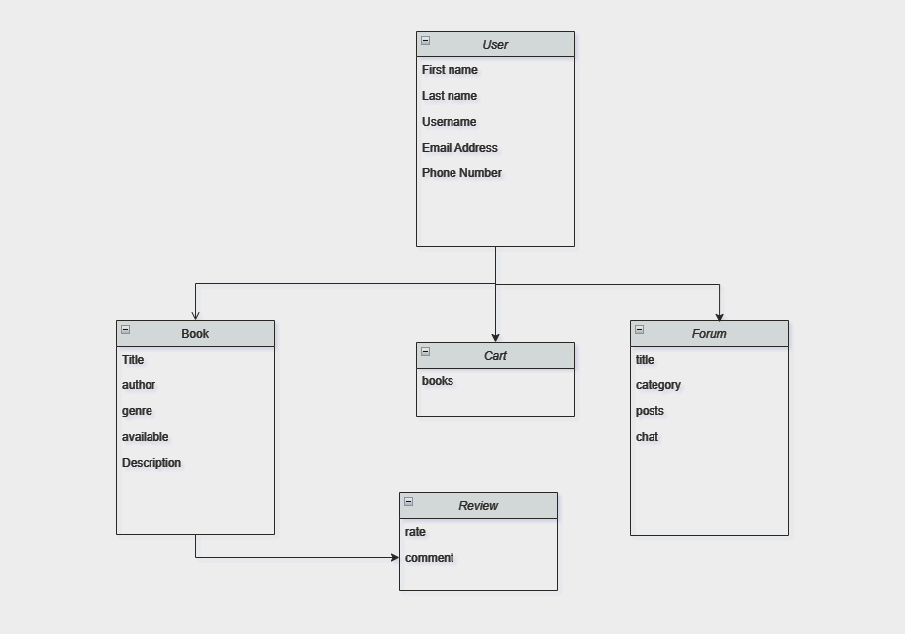
Concept Diagram

Slide 14
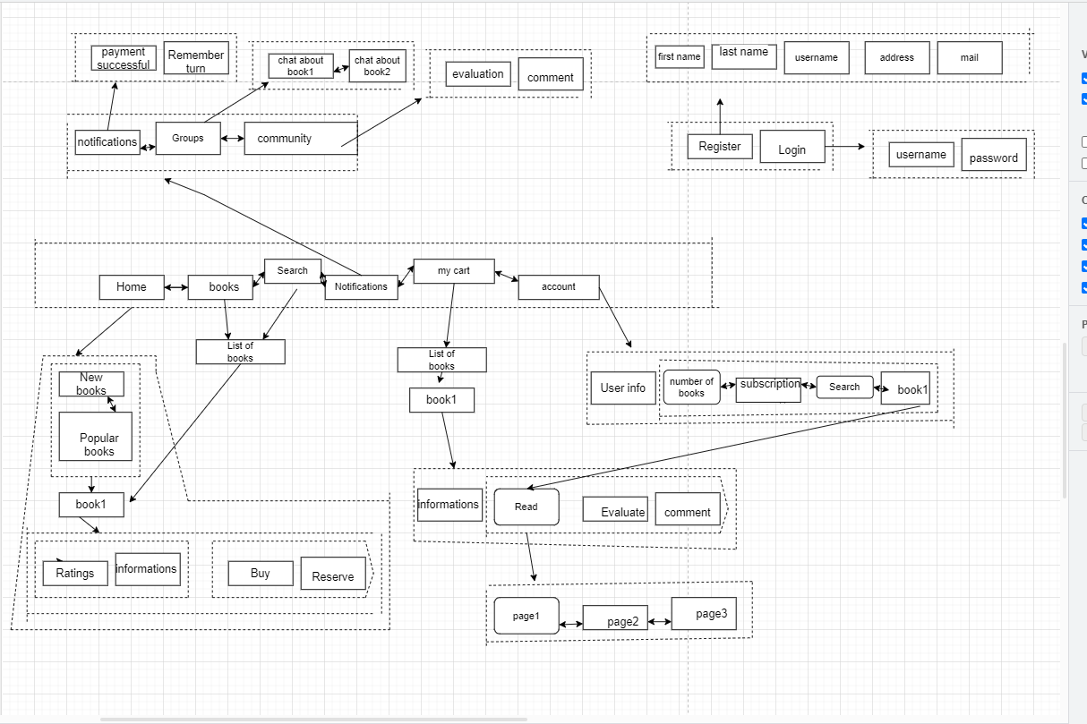
WIREFLOW

Slide 15
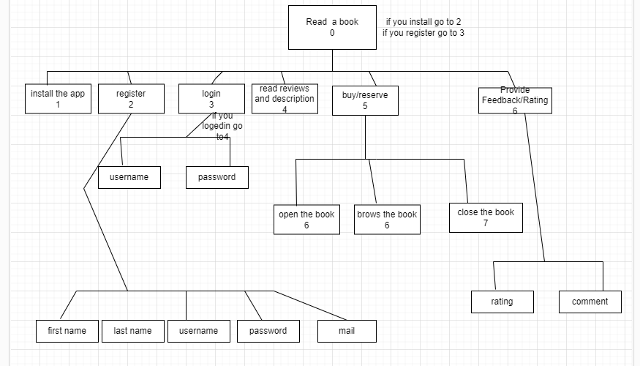
HTA

Slide 16
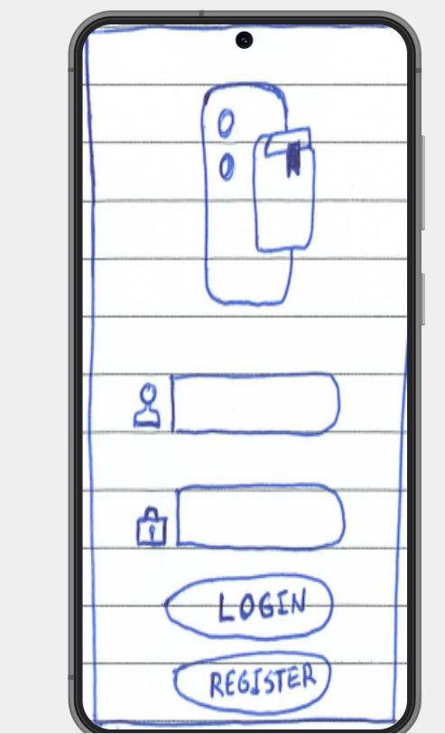
Prototipo de Baja
Fidelidad

Slide 17
LibroWave
https://www.plantillaspower-point.com
OSCAR MANUEL CONCEPCION NAPOLES
MARYAM NADHIM EDAM, EDAM
SMAIL DAHMANI

